Slide 1

Discrete Time Dynamical Systems
MTH 564 – Mathematical Modeling

Slide 2
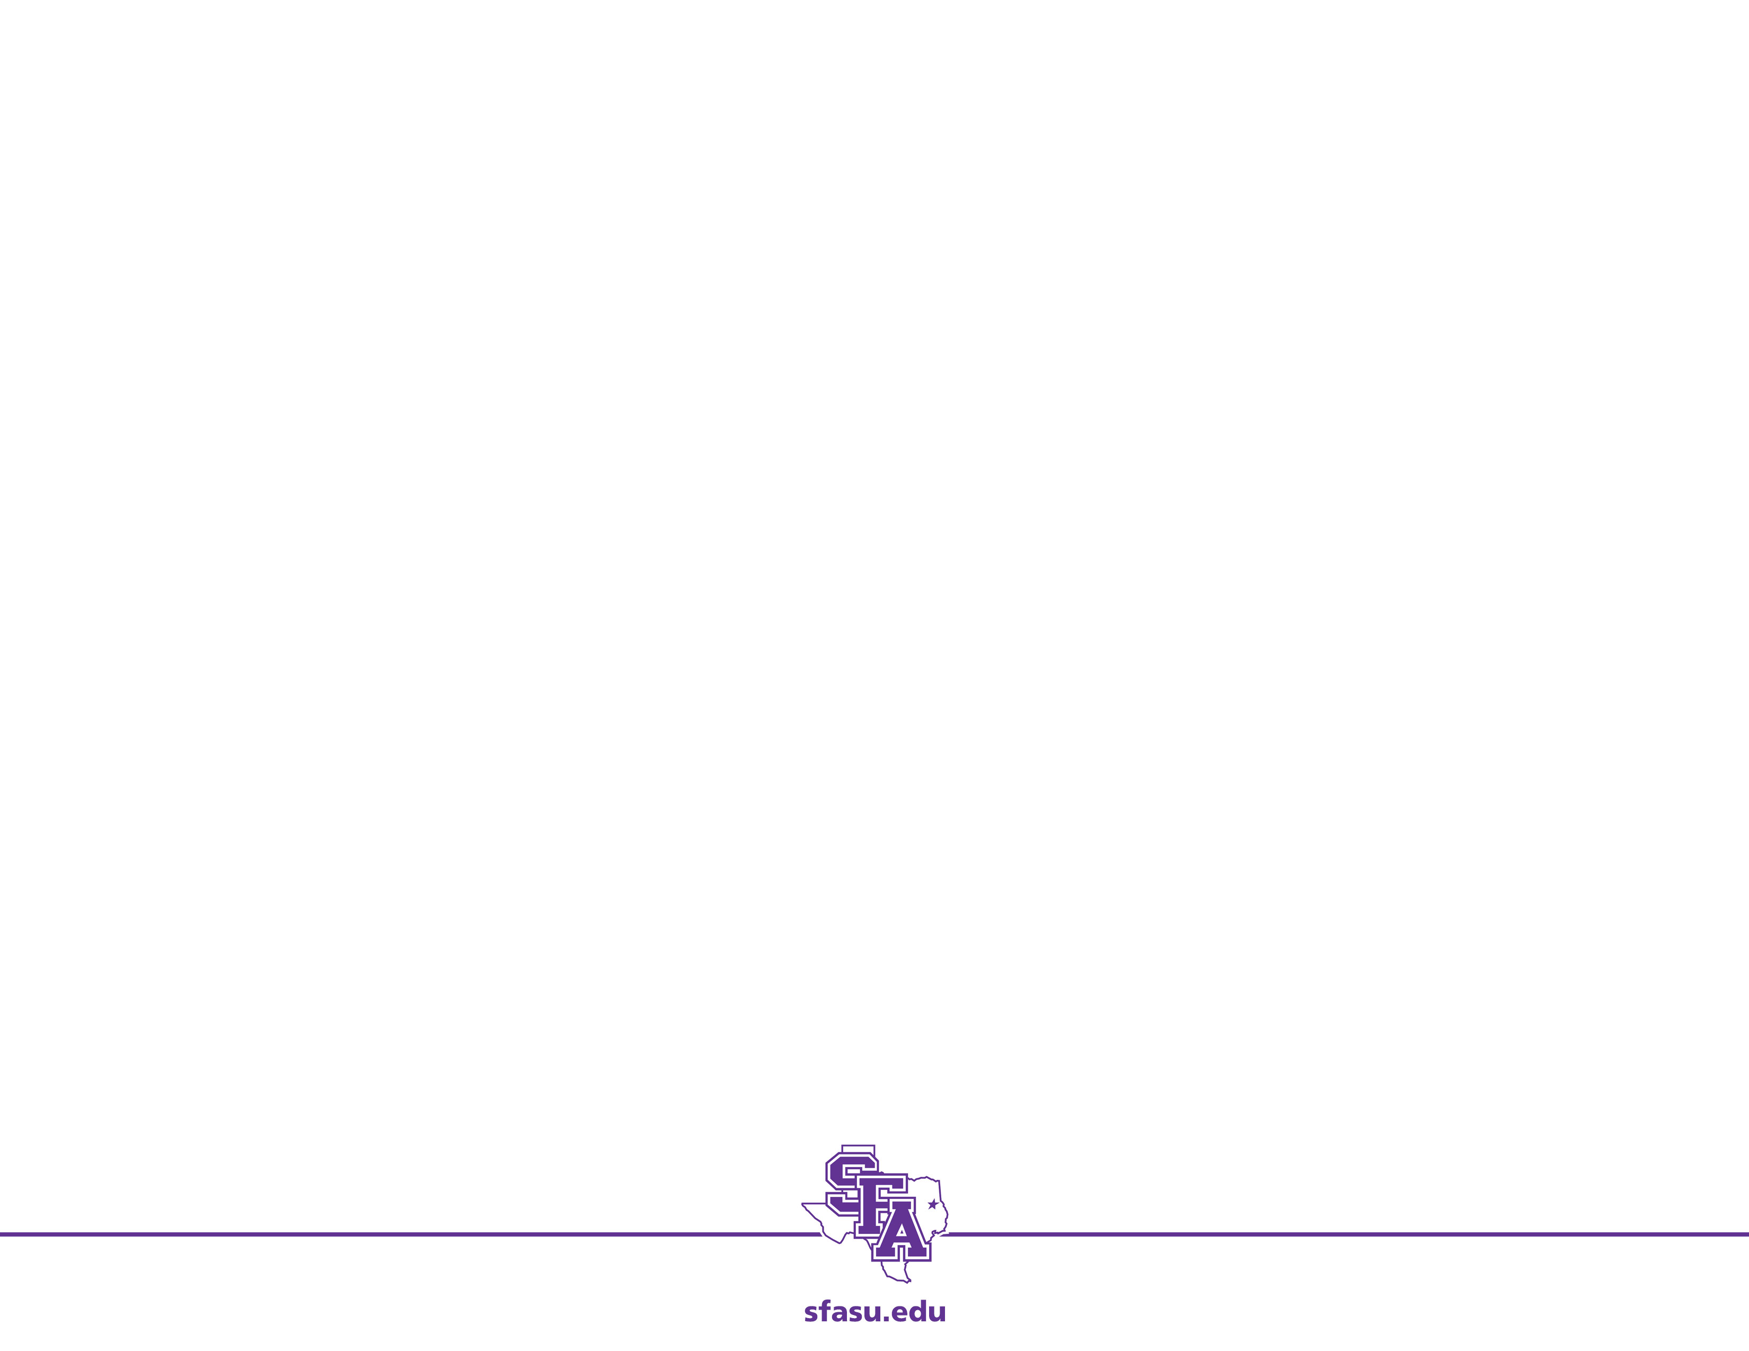
Example: Astronauts
Astronauts in training are required to practice a docking maneuver under manual control. As part of this maneuver, it is required to bring an orbiting spacecraft to rest relative to another orbiting craft. The hand controls provide for variable acceleration and deceleration, and there is a device on board that measures the rate of closing between the two vehicles.

Slide 3
Example: Astronauts
The following strategy has been proposed for bringing the craft to rest. First, look at the closing velocity. If it is zero, we are done. Otherwise, remember the closing velocity and look at the acceleration control. Move the acceleration control so that
it is opposite to the closing velocity. (i.e. if closing velocity is positive, we slow down, and we speed up if it is negative.)
move it proportional in magnitude. (i.e. brake twice as hard if we find ourselves closing twice as fast)
After a time, look at the closing velocity again and repeat the procedure. Under what circumstances will this strategy be effective?

Slide 4
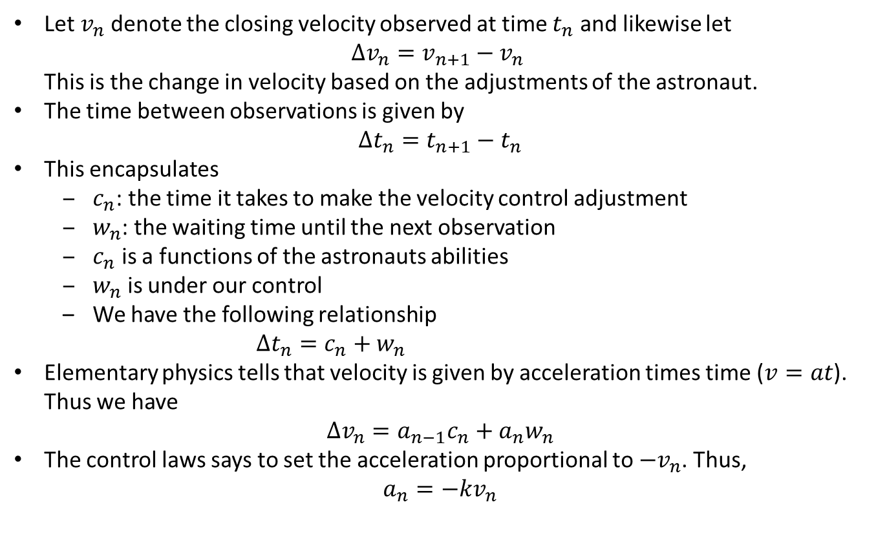
Astronaut Example: Step 1
Let $v_{n}$ denote the closing velocity observed at time $t_{n}$ and likewise let $Δv_{n}=v_{n+1}−v_{n}$ This is the change in velocity based on the adjustments of the astronaut.
The time between observations is given by
$$Δt_{n}=t_{n+1}−t_{n}$$
This encapsulates
$c_{n}$: the time it takes to make the velocity control adjustment
$w_{n}$: the waiting time until the next observation
$c_{n}$ is a functions of the astronauts abilities
$w_{n}$ is under our control
We have the following relationship ${Δt}_{n}=c_{n}+w_{n}$
Elementary physics tells that velocity is given by acceleration times time ($v=at$). Thus we have
$$Δv_{n}=a_{n−1}c_{n}+a_{n}w_{n}$$
The control laws says to set the acceleration proportional to $−v_{n}$. Thus,
$$a_{n}=−kv_{n}$$

Slide 5
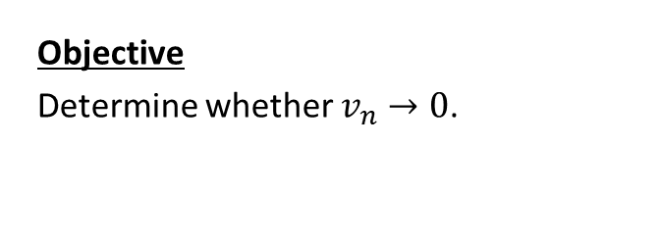
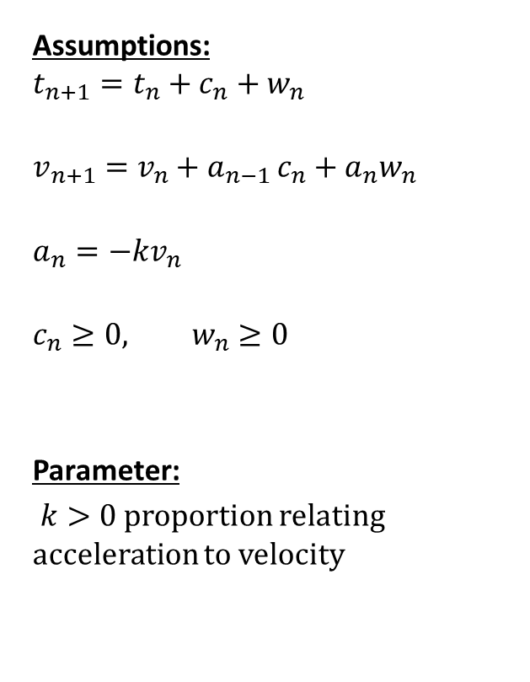
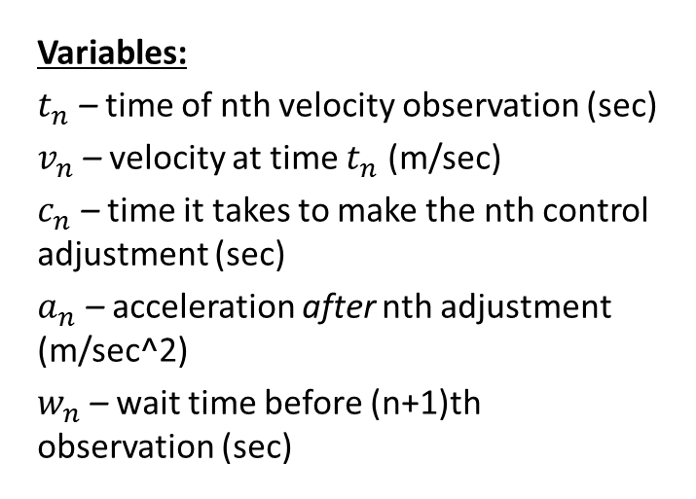
Step 1: Ask the question.
Variables:
$t_{n}$ – time of nth velocity observation (sec)
$v_{n}$ – velocity at time $t_{n}$ (m/sec)
$c_{n}$ – time it takes to make the nth control adjustment (sec)
$a_{n}$ – acceleration after nth adjustment (m/sec^2)
$w_{n}$ – wait time before (n+1)th observation (sec)
Assumptions:
$$t_{n+1}=t_{n}+c_{n}+w_{n}$$
$$v_{n+1}=v_{n}+a_{n−1 }c_{n}+a_{n}w_{n}$$
$$a_{n}=−kv_{n}$$
$$c_{n}≥0, w_{n}≥0$$
Parameter:
$k>0$ proportion relating acceleration to velocity
Objective
Determine whether $v_{n}→0$.

Slide 6
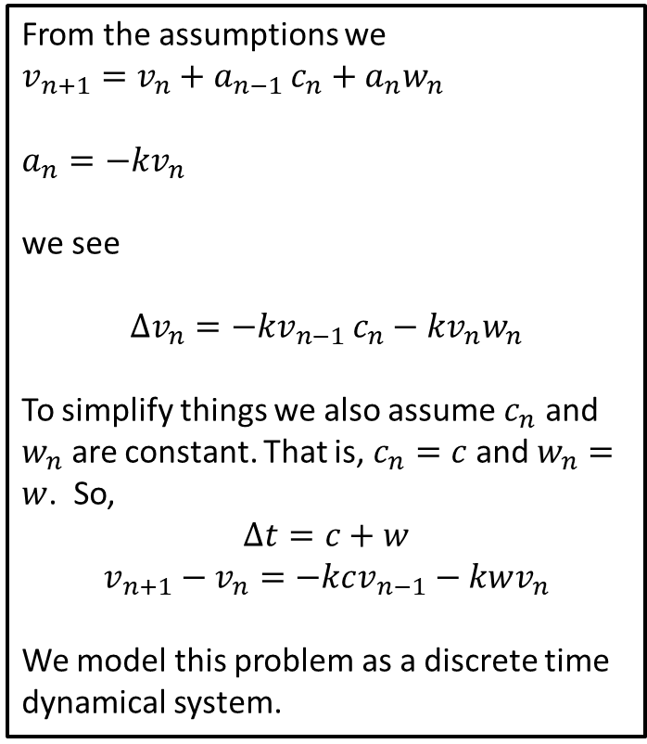
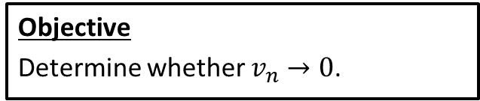
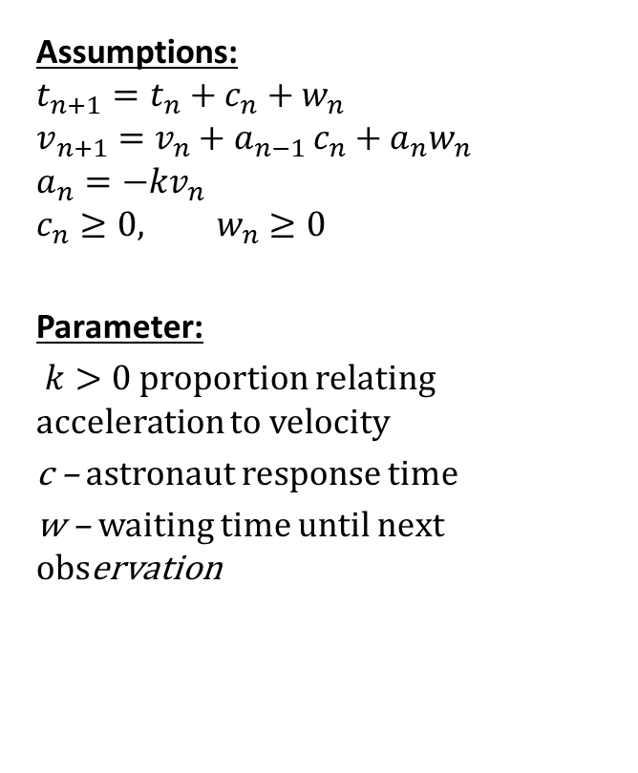
Step 2: Select the modeling approach
Assumptions:
$$t_{n+1}=t_{n}+c_{n}+w_{n}$$
$$v_{n+1}=v_{n}+a_{n−1 }c_{n}+a_{n}w_{n}$$
$$a_{n}=−kv_{n}$$
$$c_{n}≥0, w_{n}≥0$$
Parameter:
$k>0$ proportion relating acceleration to velocity
c – astronaut response time
w – waiting time until next observation
From the assumptions we
$$v_{n+1}=v_{n}+a_{n−1 }c_{n}+a_{n}w_{n}$$
$$a_{n}=−kv_{n}$$
we see
$$Δv_{n}={−kv}_{n−1 }c_{n}−kv_{n}w_{n}$$
To simplify things we also assume $c_{n}$ and
$w_{n}$ are constant. That is, $c_{n}=c$ and $w_{n}=w$. So,
$$Δt=c+w$$
$$v_{n+1}−v_{n}=−kcv_{n−1}−kwv_{n}$$
We model this problem as a discrete time dynamical system.
Objective
Determine whether $v_{n}→0$.

Slide 7
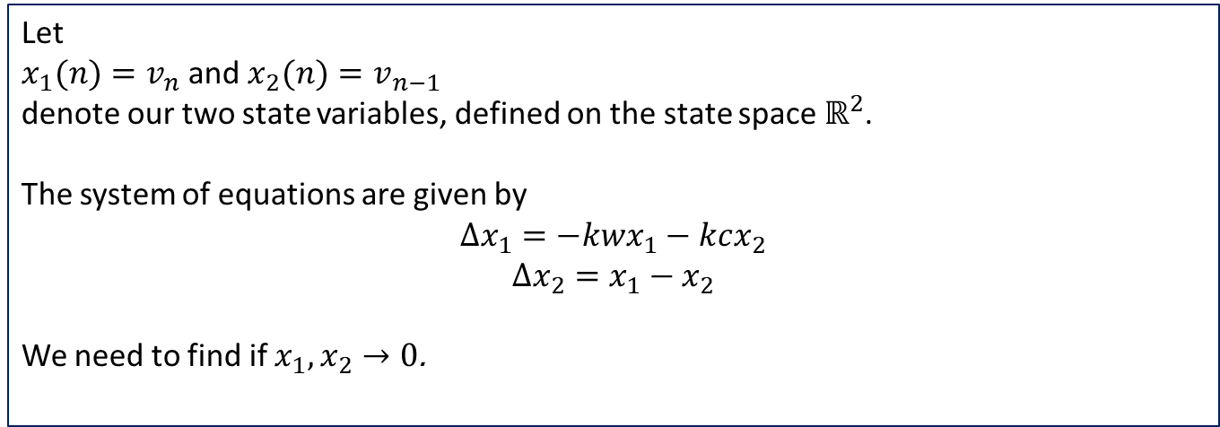
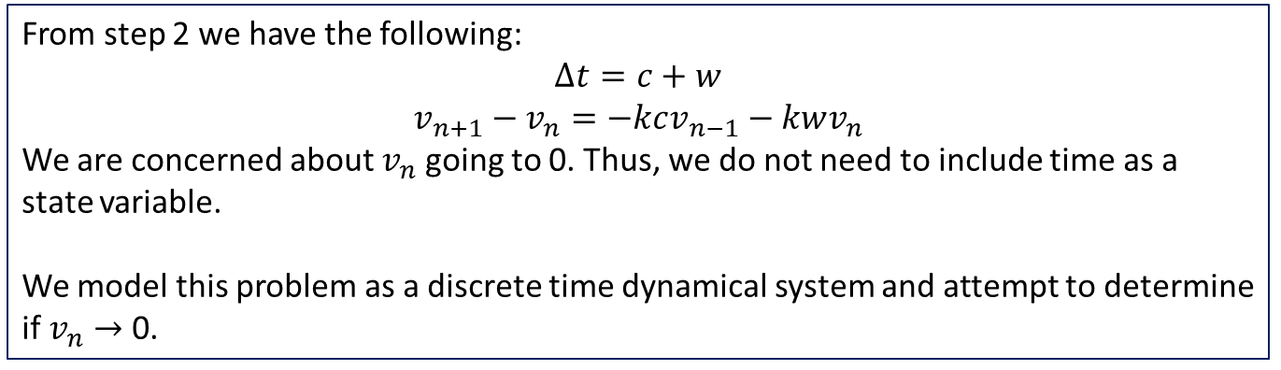
Step 3: Formulate the model
From step 2 we have the following:
$$Δt=c+w$$
$$v_{n+1}−v_{n}=−kcv_{n−1}−kwv_{n}$$
We are concerned about $v_{n}$ going to 0. Thus, we do not need to include time as a state variable.
We model this problem as a discrete time dynamical system and attempt to determine if $v_{n}→$ 0.
Let
$x_{1}(n)=v_{n}$ and $x_{2}(n)=v_{n−1}$
denote our two state variables, defined on the state space $ℝ^{2}$.
The system of equations are given by
$$Δx_{1}=−kwx_{1}−kcx_{2}$$
$$Δx_{2}=x_{1}−x_{2}$$
We need to find if $x_{1},x_{2}→0$.

Slide 8
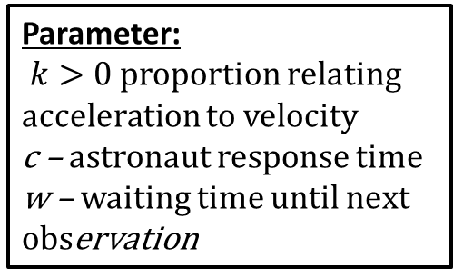

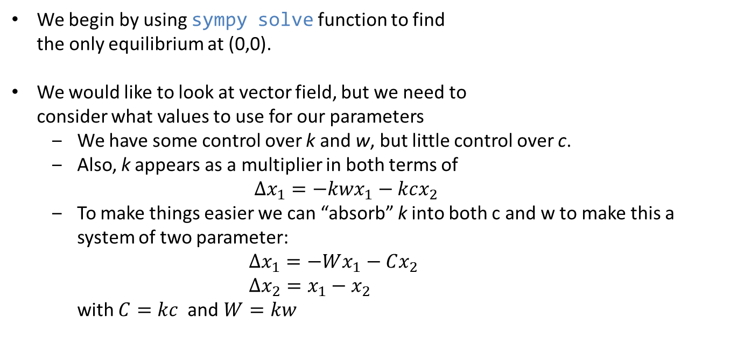
Step 4: Solve the Problem
We are studying the following dynamical system on the state space$ℝ^{2}$.
$$Δx_{1}=−kwx_{1}−kcx_{2}$$
$$Δx_{2}=x_{1}−x_{2}$$
Parameter:
$k>0$ proportion relating acceleration to velocity
c – astronaut response time
w – waiting time until next observation
We begin by using sympy solve function to find the only equilibrium at (0,0).
We would like to look at vector field, but we need to consider what values to use for our parameters
We have some control over k and w, but little control over c.
Also, k appears as a multiplier in both terms of $Δx_{1}=−kwx_{1}−kcx_{2}$
To make things easier we can “absorb” k into both c and w to make this a system of two parameter: $Δx_{1}=−Wx_{1}−Cx_{2}$ $Δx_{2}=x_{1}−x_{2}$ with $C=kc$ and $W=kw$
Notes:
The quiver function in matlibplot to plot the vector field:
$$F\left(x_{1},x_{2}\right)=〈f_{1}\left(x_{1},x_{2}\right), f_{2}\left(x_{1},x_{2}\right)〉$$
We also use contour to plot the
level sets (contours):
$$f_{1}\left(x_{1},x_{2}\right)=0$$
$$f_{2}\left(x_{1},x_{2}\right)=0$$

Slide 9
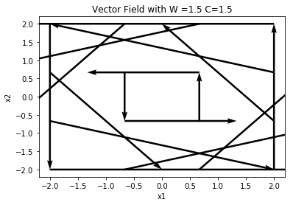
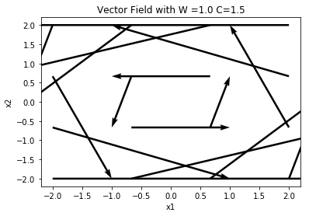
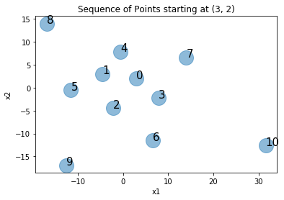
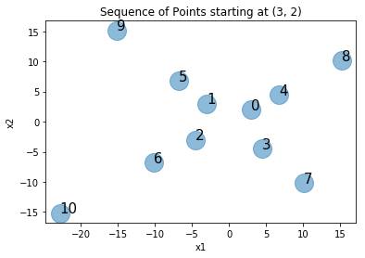
Step 4: Graph Interpretation (C,W>=1)
We make vector fields and scatter plots for different values of C and W using matlibplot quiver and scatter functions.
Notes:
Vertical blue line -
See python file section1-1pig.py

Slide 10
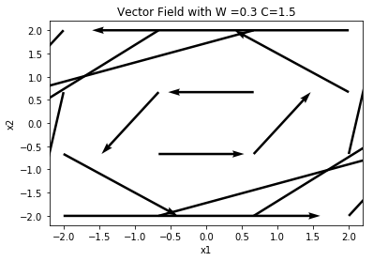
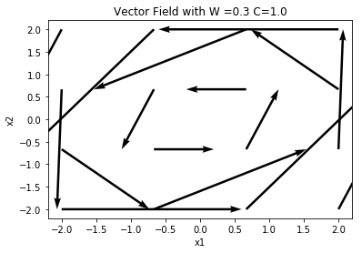
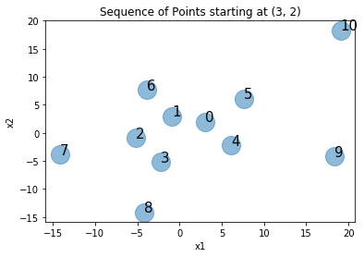
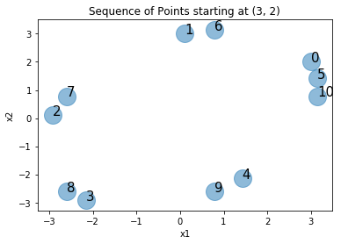
Step 4: Graph Interpretation (C >=1)
Notes:
Vertical blue line -
See python file section1-1pig.py

Slide 11
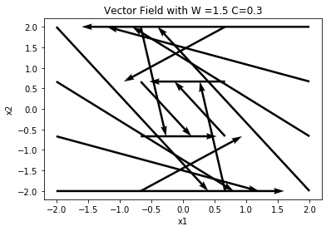
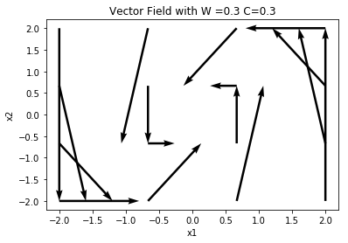
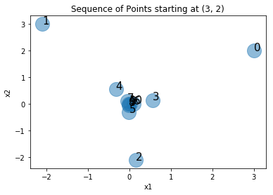
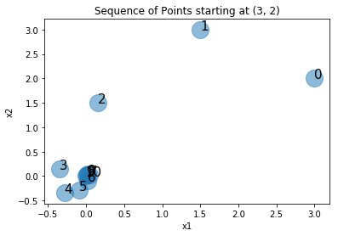
Step 4: Graph Interpretation (C < 1)
Notes:
Vertical blue line -
See python file section1-1pig.py

Slide 12

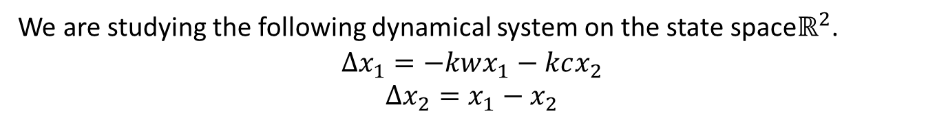
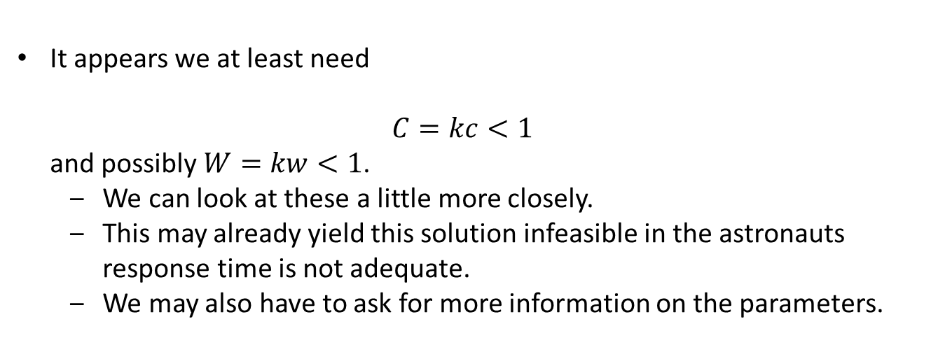
Step 4: Solve the Problem
We are studying the following dynamical system on the state space$ℝ^{2}$.
$$Δx_{1}=−kwx_{1}−kcx_{2}$$
$$Δx_{2}=x_{1}−x_{2}$$
Parameter:
$k>0$ proportion relating acceleration to velocity
c – astronaut response time
w – waiting time until next observation
It appears we at least need $C=kc<1$ and possibly $W=kw<1$.
We can look at these a little more closely.
This may already yield this solution infeasible in the astronauts response time is not adequate.
We may also have to ask for more information on the parameters.
Notes:
The quiver function in matlibplot to plot the vector field:
$$F\left(x_{1},x_{2}\right)=〈f_{1}\left(x_{1},x_{2}\right), f_{2}\left(x_{1},x_{2}\right)〉$$
We also use contour to plot the
level sets (contours):
$$f_{1}\left(x_{1},x_{2}\right)=0$$
$$f_{2}\left(x_{1},x_{2}\right)=0$$

Slide 13

Step 4: Graph Interpretation (More)
Let’s run a couple of scatterplots on the cases that have potential.
They have graphs similar to have on the left and the state of the system appears to be approachin (0,0).

Slide 14
Step 5: Answer the question
So, what’s the answer
IDK…it’s complicated.
A completely satisfactory solution is not obtainable with elementary graphical methods.
We may need to get more information on our parameters
We may have to do more work and research more sophisticated methods.
It does appear that the method will be effective as long as the time interval between adjustments is not long, the response time for the astronaut is adequate, and the adjustment proportion is not too large.
The longer the time interval between adjustments the “lighter” the adjustment must be. Accounting for human error and equipment (measurement) error, the we may require an even lighter touch.
More frequent adjustments require more frequent measurements and operations by the astronaut, but should produce better results.
We have to reassess and look our resources (time, money, labor) to determine how to pursue this solution.

